Slide 1
EDB Failover Manager
Erin Nielsen Sr. Sales Engineer

Slide 2



Why Failover Manager
Ensure Business Continuity
Maintain High Availability
Upgrade with Minimal Downtime
Monitor health databases and identify failures quickly
Meet your SLAs by switching over to the most recent standby
Switchover on demand to move the primary to standby for maintenance
Notes:
A few minutes or a few hours of downtime can cost businesses significant amounts of money. EnterpriseDB's fault tolerant clustering technology and redundant architecture eliminate single points of failure and protect against system outages to achieve high availability.

Slide 3
High-level Overview of Failover Manager
Monitors database health; Detects failures and acts
Automatically fails over to the most current standby and reconfigures others
Provides easy switchover promotion of standby to master
Reconfigures load balancers on failover and promotion if integrated
Avoids “split brain” scenarios
Prevents two nodes from thinking that each is primary
https://www.enterprisedb.com/docs/efm/latest/architecture/
Notes:
EDB Failover Manager also supports switchover, where the primary database becomes the standby database, and the standby database becomes the primary database, all without data loss.
Switchover can help when upgrading the database environment in a rolling upgrade mode, where the standby environment is patched first, then switchover is performed, and in the last step the primary database is patched. Rolling upgrades are perfect for environments where very little downtime is allowed.
Also, it’s very important to know that the Failover Manager can detect and counteract split-brain situations.
Using switchover to allow rolling upgrades, and a configurable virtual IP address, EDB Failover Manager ensures database high availability

Slide 4
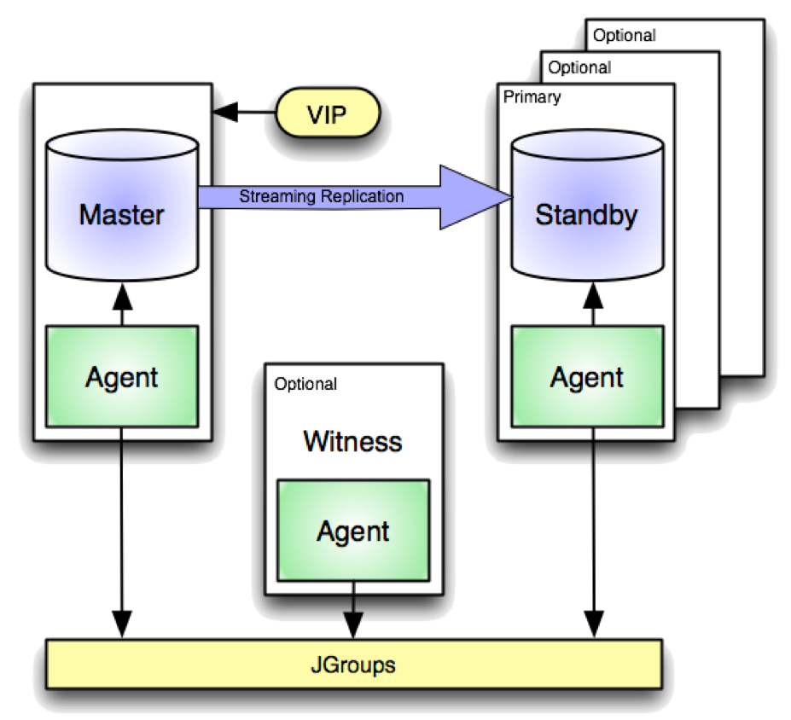
Failover Manager Components
Master or Primary Node
The primary node is the primary database server that is servicing database clients.
One or more Standby Nodes
A standby node is a read-only replica of the primary node synchronized by streaming replication.
Witness Node
The witness node provides a third opinion when needed to break a conflict when the master and standby do not agree on the status of the master.
Only required in 1 master - 1 standby setups
EFM Agents
Runs on Master, Standby and Witness nodes
Monitors the health of Master and Standby databases
Talks with each other to determine cluster health
Notifies DBA of all cluster status changes when detected
Initiates failover if needed
Notes:
EFM monitors the database environment and in case of a failure of the primary database, performs a failover.
EFM is based on what is known as streaming replication, whereby all changes that are committed to the primary database are replicated to a shadow database (or in other words, to a standby). This creates a copy of the primary database that is updated in real-time mode and takes over the role of the primary database in the case of its failure. One or more standby databases can be configured. Replication can be synchronous or asynchronous.
EDB Failover Manager groups the primary and standby databases into an EFM cluster and monitors the status of the environment.
EFM uses two basic types of nodes in a HA cluster: a master database node that services transactions in real time and standby database nodes receiving all changes to the master via streaming replication. Both types of nodes use Failover Manager agents to create a configuration without a single point of failure.
By using a load balancer in front of the cluster, you can horizontally scale out your read capabilities by allowing the replicas to service queries and reports. The separate witness node that only runs an agent is only needed for HA clusters containing only 1 master and 1 replica – it provides a third opinion when needed to break a conflict when the master and replica don’t agree on the status of the master.
JGroups is a library for reliable one-to-one or one-to-many communication written in the Java language. It can be used to create groups of processes whose members send messages to each other. JGroups enables developers to create reliable multipoint applications where reliability is a deployment issue.

Slide 5

Choosing a Deployment Architecture
https://www.enterprisedb.com/docs/efm/latest/efm_deploy_arch/
Notes:
With the capabilities of Failover Manager, EDB has designed four basic architectures to run a high-availability environment:

Slide 6
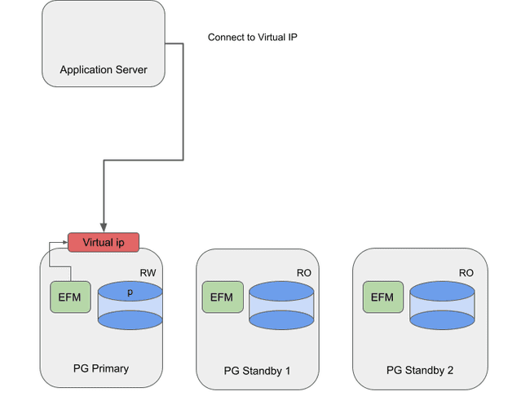
Deployment Architecture - Virtual IP (VIP)
Failover Manager has a key capability to manage VIP addresses out of the box.
VIP addresses allow applications to connect to a single IP address that is being routed to the primary database server. This architecture is the most basic solution to run when VIP addresses are available in your environment.
Notes:
EDB Failover Manager also supports the configuration of a virtual IP address that is responsible for database access from the client side. This address normally points to the master database. If a failover or switchover is triggered and a standby gets the primary role, the virtual IP address can be automatically reconfigured and database clients are immediately redirected to the new primary database.
If implemented in the cloud an elastic IP can be used say on AWS and then changed upon failover via post-promotion script.
Show efm.properties
https://www.enterprisedb.com/docs/efm/latest/04_configuring_efm/01_cluster_properties/
Show efm.nodes

Slide 7
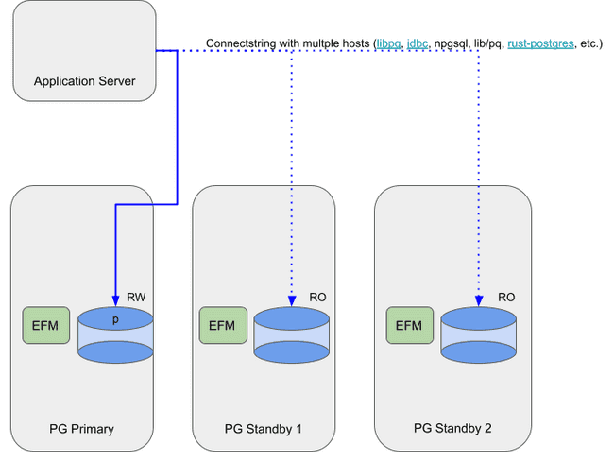
Deployment Architecture – Client Connect Failover
PostgreSQL client libraries like libpq and jdbc allow for client connection failover.
With client connection failover, the connection string contains multiple servers (host=srv1,srv2) and the client library loops over the available hosts to find a connection that is available and capable of read-write operations. This capability allows clients to follow the master during a switchover. This solution doesn't rely on virtual IP addresses.
Notes:
These libraries and drivers provide interfaces for interacting with PostgreSQL databases from different programming environments.

Slide 8
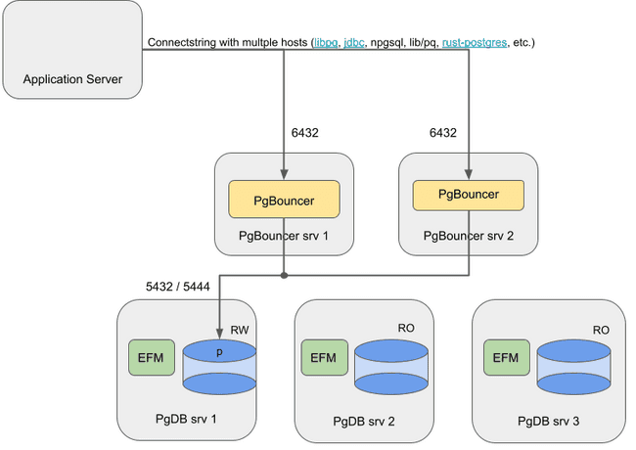
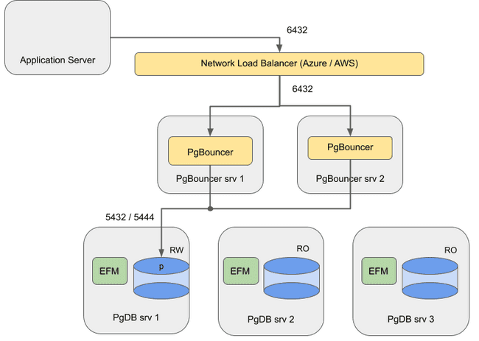
Deployment Architecture – PgBouncer
PgBouncer adds capabilities such as connection pooling and the option to halt traffic. You can also use it as a proxy between the client and the Postgres database server.
By leveraging the integration options in Failover Manager to run reconfiguration of PgBouncer during a failover, you can use PgBouncer to route the traffic to the correct primary database server.
On Premises
In the Cloud
Notes:
PgBouncer on its own is not HA. It does not have multi-host configuration, failover or detection.
PgBouncer must be on a separate node.

Slide 9
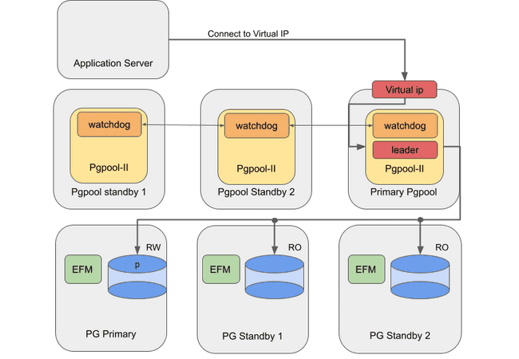
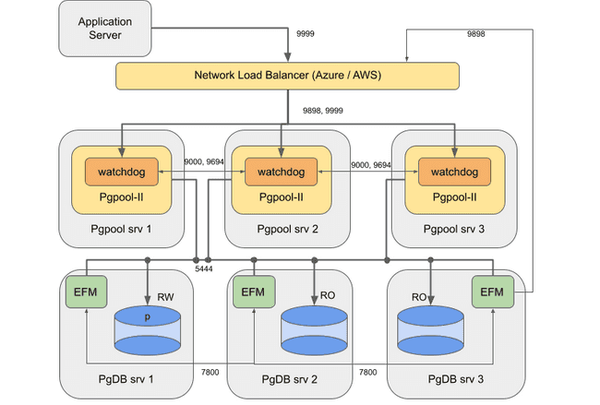
Deployment Architecture – EDB Pgpool-II
Pgpool-II is another tool used as a proxy between the client and the Postgres database server. Pgpool-II adds capabilities such as running in cluster mode with a Watchdog, managing VIPs, and read-only scalability.
Failover Manager has native capabilities to integrate with Pgpool-II to redirect traffic to another primary during Database failover operations.
On Premises
In the Cloud
Notes:
Pgpool-II Overview
Pgpool-II (Pgpool) is an open-source application that provides connection pooling and load balancing for horizontal scalability of SELECT queries on multiple Standbys in EPAS and community Postgres clusters. For every backend, a backend_weight parameter can set the ratio of read traffic to be directed to the backend node. To prevent read traffic on the Primary node, the backend_weight parameter can be set to 0. In such cases, data modification language (DML) queries (i.e., INSERT, UPDATE, and DELETE) will still be sent to the Primary node, while read queries are load-balanced to the Standbys, providing scalability with mixed and read-intensive workloads.
EnterpriseDB supports the following Pgpool functionality:
Load balancing
Connection pooling
High availability
Connection limits

Slide 10
Failover Manager – EFM Utility
Failover Manager provides the efm utility to assist with cluster management for those users that are a member of the efm group
Utilities include features such as:
View the status of the cluster
Perform a manual failover of a standby to primary (promote)
Assign a failover priority to a standby node in the case of more than 1 standby in a cluster
Allowing a node to join a cluster
Disallow a node to join a cluster
https://www.enterprisedb.com/docs/efm/latest/07_using_efm_utility/
Notes:
EFM monitors the database environment and in case of a failure of the primary database, performs a failover.
EFM is based on what is known as streaming replication, whereby all changes that are committed to the primary database are replicated to a shadow database (or in other words, to a standby). This creates a copy of the primary database that is updated in real-time mode and takes over the role of the primary database in the case of its failure. One or more standby databases can be configured. Replication can be synchronous and asynchronous.
EDB Failover Manager groups the primary and standby databases into an EFM cluster and monitors the status of the environment.
Also, it’s very important to know that the Failover Manager can detect and counteract split-brain situations.
Using switchover to allow rolling upgrades, and a configurable virtual IP address, EDB Failover Manager ensures database high availability

Slide 11
Failover Manager – Cluster Configuration
efm.properties allows you to configure Failover Manager for your business use cases
EFM Pulse check timeout
Email notifications in case of failovers
Virtual IP Address, Pgpool, etc.
Custom scripting
https://www.enterprisedb.com/docs/efm/latest/04_configuring_efm/01_cluster_properties/

Slide 12
Demo

Slide 13
Next Steps
Business Goals
Business Challenges
ROI Analysis

Slide 14
Thank you
Erin Nielsen
enielsen@enterprisedb.com
(720) 232-4151

